Slide 1
Ipilimumab Treatment of Elderly Patients

Slide 2


Concerns with Treating the Elderly with Immune Checkpoint Inhibitors
After all, older patients are more frail:
Socially isolated
Physiologic changes
Decreased renal function
Increased body fat
Decreased marrow reserve
Decreased stamina
Already reduced life expectancy
Comorbidities
Polypharmacy

Slide 3
Misconceptions about the Elderly in with the Use of Yervoy
Myth #1:
The immune system in the elderly is defective and responses to Yervoy are diminished

Slide 4


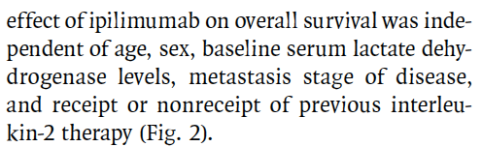
Improved Survival with Ipilimumab in Patients with Metastatic Melanoma
Hodi FS et al. N Engl J Med 2010; 363(8):711-23.

Slide 5
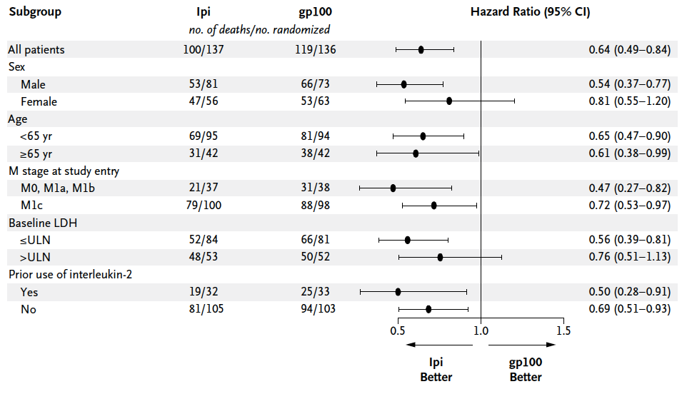
Phase 3 Ipilimumumab vs. gp100 Trial: Subgroup Analysis for OS
Hodi FS et al. N Engl J Med 2010; 363(8):711-23.
LDH: lactate dehydrogenase; ULN: upper limit of normal

Slide 6
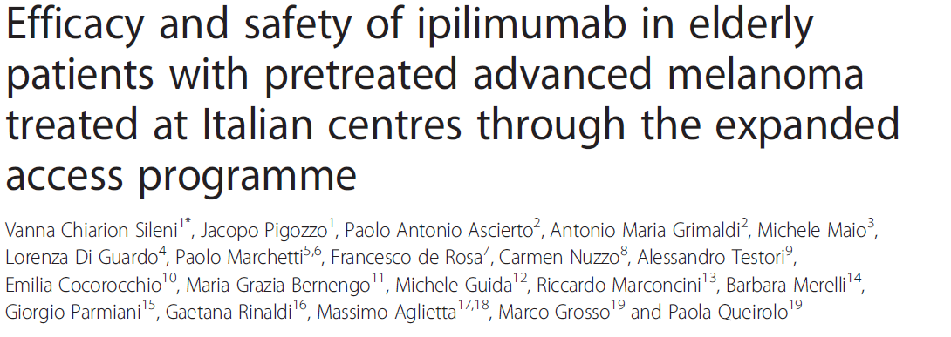

Slide 7
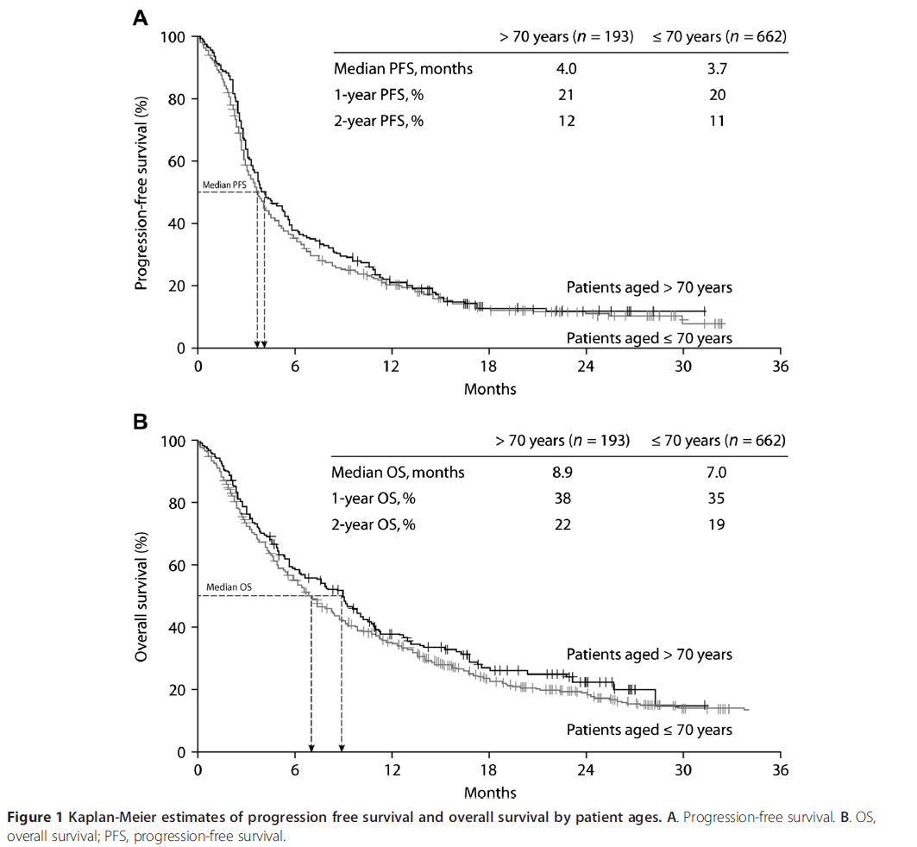

Slide 8
Misconceptions about the Elderly in with the Use of Yervoy
Myth #2:
Elderly patients have an increased incidence of immune mediated adverse events.

Slide 9
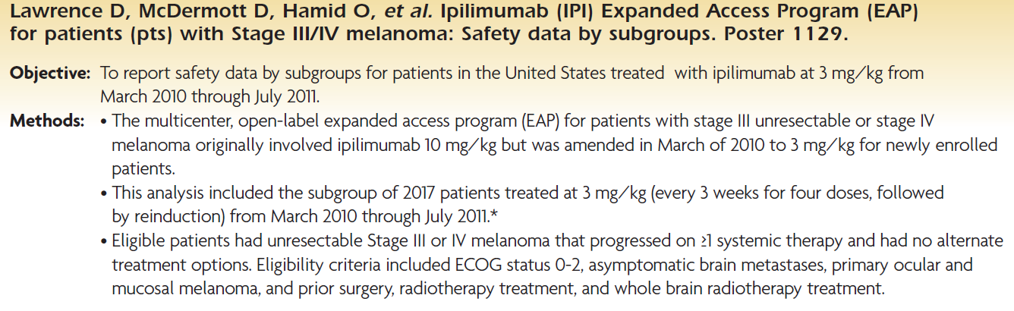

Slide 10
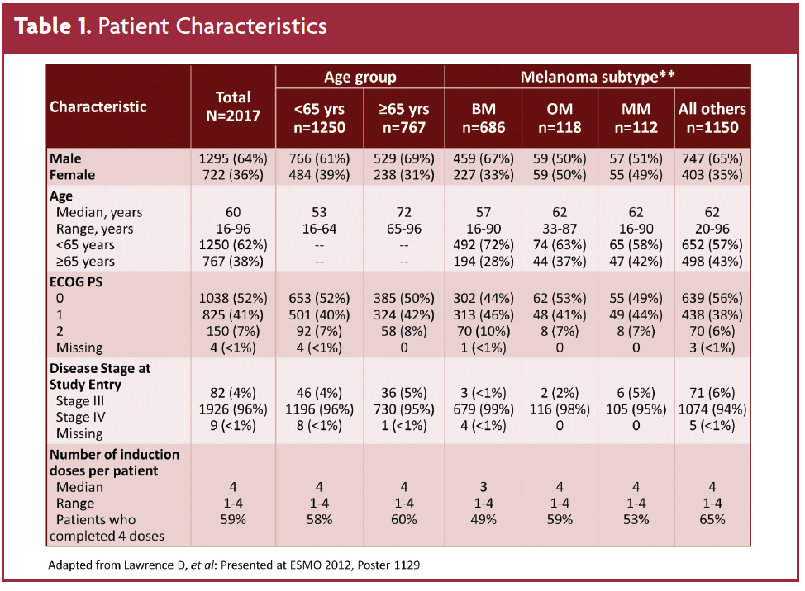

Slide 11
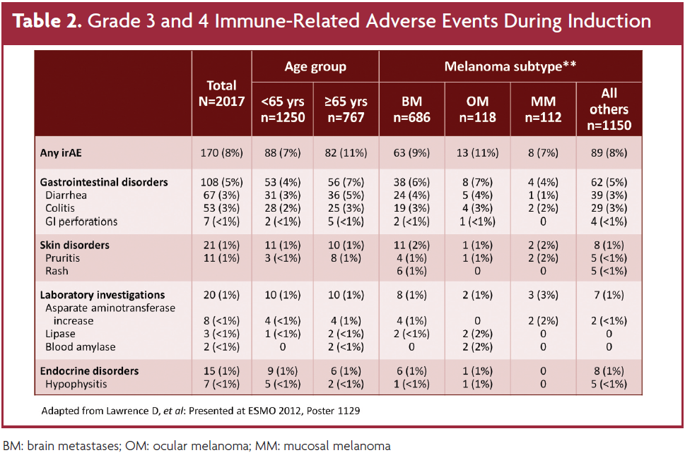

Slide 13
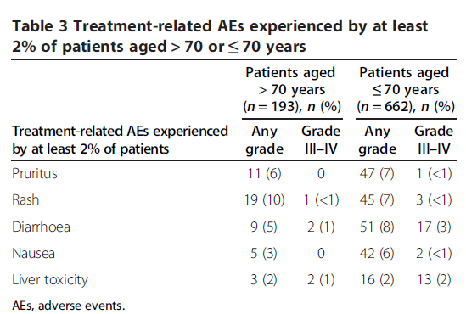

Slide 14


Impact of Social Isolation
Social isolation has been linked with increased mortality¹
Need to ensure that if the patient cannot consistently monitor his/her symptoms, a reliable caregiver is doing so
Importance of multidisciplinary team
Community nursing, early palliative care referral, Meals on Wheels, etc.
Regular telephone calls
Associated with less distress, anxiety and more timely referral to appropriate follow up and specialist referrals²
1. Kroenke CH et al. J Clin Oncol 2006; 24(7):1105-11.
2. Kornblith AB et al. Cancer 2006; 107(11):2706-14.

Slide 15
Multidisciplinary Approach
Nurses
Oncologists (medical, radiation, surgical)
Subspecialists (GI, endo, derm, etc.)
Patients
Palliative care team
Pharmacists
Families/ care givers
Social workers
derm: dermatology; endo: endocrinology; GI: gastroenterology

Slide 16
Case #1: Yervoy and the Elderly
75 year old male presents with an 8mm ulcerated lesion on the left neck
PMH: HTN, diabetes, neuropathy
Biopsy diagnosis of melanoma
Sentinal node biopsy is negative
Surgery completed and lesions resected
1 year later, he developed a recurrent mass in neck
Referred back to med onc
Treated with radiation to the neck
Restaging completed with a diagnosis of pulmonary metastases
BRAF WT
ECOG borderline
Treated with DTIC

Slide 17
Advanced Melanoma, Disease Tempo and Ipilimumab

Slide 18


Melanoma Disease Tempo
Advanced melanoma is an aggressive disease that can progress quickly, BRAF mutated patients often fall into this category.
The clinical benefit of ipilimumab is often delayed following infusions

Slide 19
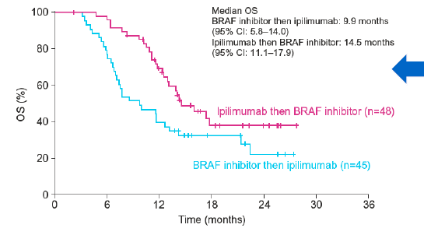
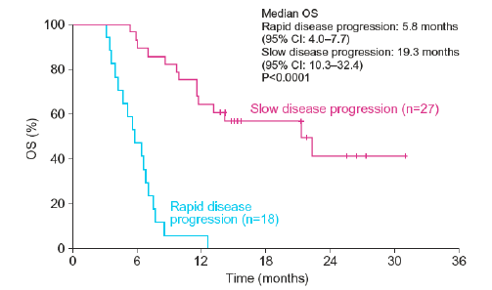
Sequencing ipilimumab in BRAF mutant patents

Slide 20
Case #2
65 year old female presents with numerous nodules on her leg
Biopsy completed and a diagnosis of melanoma
No obvious primary
3 lesions excised
6 months later, more lesions appeared
Returned to med onc and arranged for staging
BRAF MT
MRI normal
CT did not show any definite metastases
Med onc send pt to melanoma Surgeon (Dr. Frances Wright) for IL-2 injections
Injections administered to the nodules with a moderate response
New small nodules on her buttocks
Not a viable option to excise all these lesions due to the number of them

Slide 21
Case #3
47 year old male recent Iraqi immigrant
Presents to med onc with large chest wall and left axillary mass, increasing SOB and unwell
Initially diagnosed by GP as shingles
Seen by Surgeon; Biopsy done; BRAF testing done
A few days later, presented in ER with pleural effusion
Physical presentation: Large chest wall and left axillary mass, tense abdomen,
CT shows multiple left axillary lesions up to 12 cm in size; a large left pleural effusion; abdominal ascites
CT head was negative for metastases
While awaiting BRAF results and the need for urgent treatment, pt started on CarboTaxol
BRAF results received 6 days later, pt is BRAF MT

Slide 22
Ipilimumab Treatment of Patients with Brain Metastisis
What is your expected survival with brain mets?

Slide 23
What is your expected survival with brain mets?

Slide 24
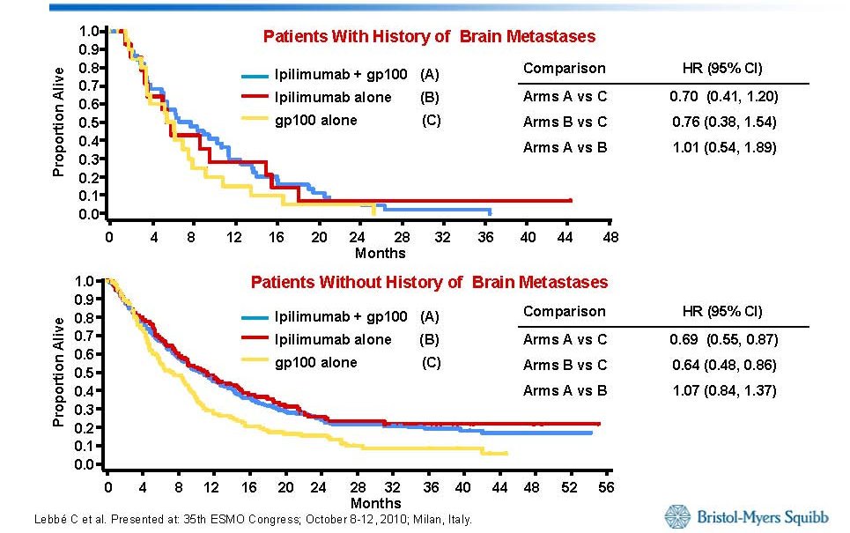
Subanalysis of Patients With CNS Metastases in the Phase III MDX010 MDX010-20 Trial: Overall Survival
Lebbé C et al. Presented at: 35th ESMO Congress; October 8-12, 2010; Milan, Italy.

Slide 25
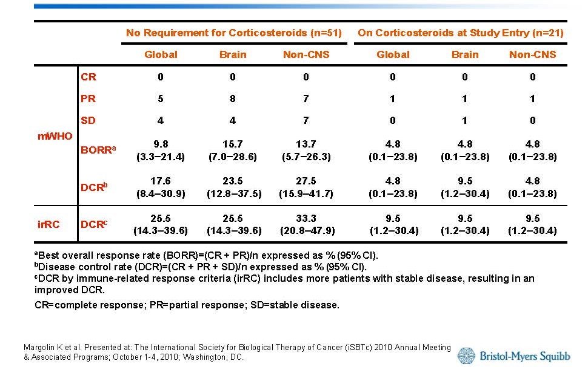
Phase II Trial of Ipilimumab in Patients With Brain Metastases: Best Overall Response
Margolin K et al. Presented at: The International Society for Biological Therapy of Cancer (iSBTc) 2010 Annual Meeting & Associated Programs; October 1-4, 2010; Washington, DC.

Slide 26
Brain mets summary slide
To be added by Jamie

Slide 27
Case 4; Brain mets
58 year old male
BRAF WT
Presents with melanoma lesion on torso
Excised successfully
3 years later presents with severe headaches
CT shows recurrent mets in the brain
On steriods due to seizures and severe headaches
Able to taper decadron to 4mg per day

Slide 28
Summary Slide

